Slide 1
QUIC
Redefining Internet Transport
Presenter: Jana Iyengar
Notes:
This community bears battle scars from years of trying to deploy DCCP, SCTP, and now MPTCP. Some ideas in QUIC will be familiar to you and that's no accident. QUIC borrows liberally from these protocols where possible, and includes deployability as a design goal. A key difference between past proposals and QUIC is that QUIC is getting deployed widely alongside its development. A non-trivial fraction of Internet traffic is now QUIC. The lessons driving the design are active deployment considerations for real large-scale applications over the commodity Internet.

Slide 2
QUIC
Redefining Internet Transport
Reinventing?
Presenter: Jana Iyengar

Slide 3
QUIC
Redefining Internet Transport
Doing
Right!
Presenter: Jana Iyengar

Slide 4

How do you make the web faster?
$BROWSER
HTTP/1.1
TLS 1.2
User-perceived latency
TCP
IP
Physical Network
google.com

Slide 5
How do you make the web faster?
$BROWSER
HTTP/1.1
TLS 1.2
User-perceived latency
TCP
IP
Physical Network
Build a carrier-grade network
Google CDN
google.com
google.com

Slide 6
How do you make the web faster?
$BROWSER
Chrome
Launch your own browser
Update HTTP
HTTP/1.1
HTTP/2
TLS 1.2
User-perceived latency
TCP
IP
Physical Network
Build a carrier-grade network
Google CDN
google.com
google.com

Slide 7
How do you make the web faster?
$BROWSER
Chrome
Launch your own browser
Update HTTP
HTTP/1.1
HTTP/2
TLS 1.2
User-perceived latency
TCP
???
Update
transport
IP
Physical Network
Build a carrier-grade network
Google CDN
google.com
google.com

Slide 8

What is QUIC?

Slide 9
QUIC
Quick UDP Internet Connections
A reliable, multiplexed transport over UDP
Always encrypted
Reduces latency
Runs in user-space
Open sourced in Chromium

Slide 10
What is QUIC?
New transport designed to reduce web latency
TCP + TLS + SPDY over UDP
Faster connection establishment than TLS/TCP
0-RTT usually, 1-RTT sometimes
Deals better with packet loss than TCP
Has Stream-level and Connection-level Flow Control
FEC recovery
Multipath
*except for HTTP/2 headers, which should be fixed as well.
Notes:
talk to : rapid deployment on both sides enables us to explore both things like improved congestion and new cool things like semi-reliable transport.

Slide 11
Where does it fit?
HTTP/2
HTTP/2 API
QUIC
TLS 1.2
TCP
UDP
IP

Slide 12
Always encrypted
Comparable to TLS
Perfect forward secrecy, with more efficient handshake
IP spoofing protection
Signed proof of address
Inspired TLS 1.3’s 0-RTT handshake
Plan to adopt TLS 1.3 when complete
more crypto details...

Slide 13
Connection establishment
Connection identified by Connection ID
As opposed to common 5-tuple
64 bits
Chosen randomly by the client
Enables connection mobility across IP, port
Notes:
talk to : rapid deployment on both sides enables us to explore both things like improved congestion and new cool things like semi-reliable transport.

Slide 14
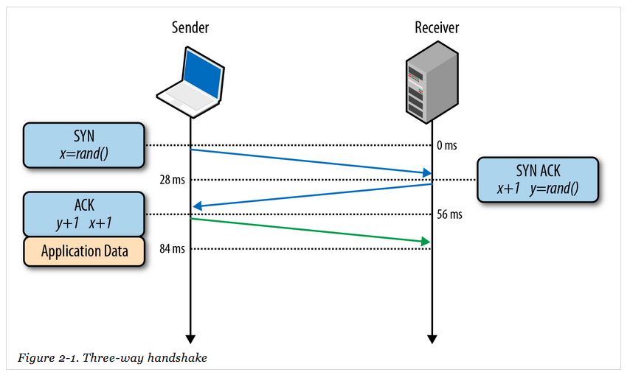
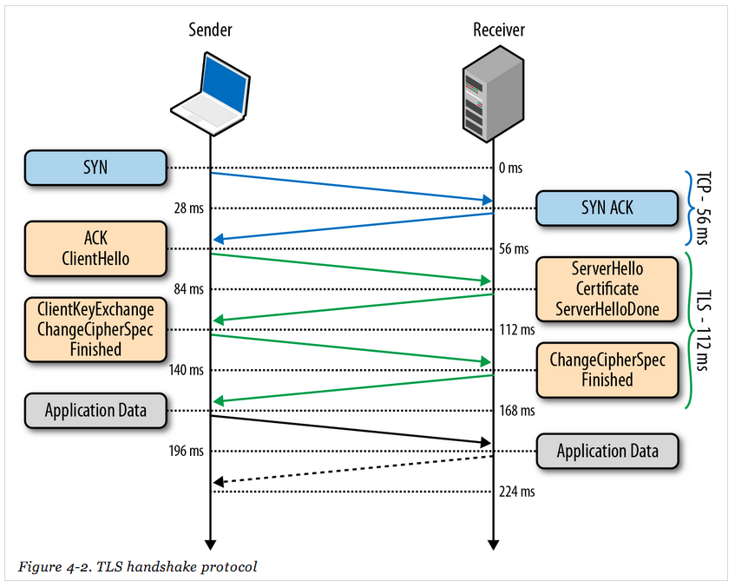
0-RTT connection establishment
TCP
TCP + TLS
QUIC
(equivalent to TCP + TLS)

Slide 15
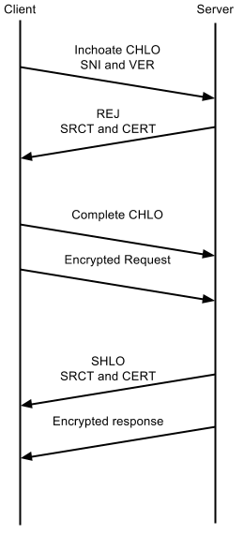
First-ever connection - 1 RTT
No cached information available
First CHLO is inchoate (empty)
Simply includes version and server name
Server responds with REJ
Includes server config, certs, etc
Allows client to make forward progress
Second CHLO is complete
Followed by initially encrypted request data
Server responds with SHLO
Followed immediately by forward-secure encrypted response data

Slide 16
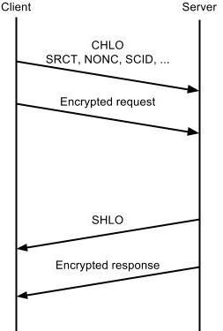
Subsequent connections - 0 RTT
First CHLO is complete
Based on information from previous connection
Followed by initially encrypted data.
Server responds with SHLO
Followed immediately by forward-secure encrypted data

Slide 17
Congestion control & reliability
QUIC builds on decades of experience with TCP
Incorporates TCP best practices
TCP Cubic - fair with TCP
FACK, TLP, F-RTO, Early Retransmit...
More flexibility going forward
Improved congestion feedback, control over acking
Better signaling than TCP

Slide 18
Better signaling than TCP
Retransmitted packets consume new sequence number
No retransmission ambiguity
Prevents loss of retransmission from causing RTO
More verbose ACK
TCP supports up to 3 SACK ranges
QUIC supports up to 256 NACK ranges
Per-packet receive times, even with delayed ACKs
ACK packets consume a sequence number

Slide 19

Effective
How quick is QUIC?

Slide 20


Measuring performance
Controlled Experiments
Client Side
Latency, Bandwidth, Quality of Experience, Errors
Server Side
Latency, Bandwidth, QUIC Success Rate
Fine Grained Analysis
By ASN, Server, OS, Version

Slide 21
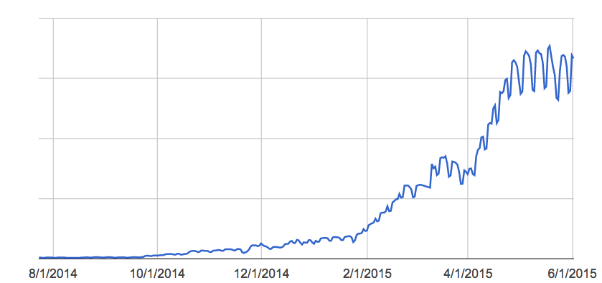
Deployment timeline
Tested at scale, with millions of users
Chrome Canary: June, 2013
Chrome Stable: April, 2014
Ramped up for Google traffic in 2015

Slide 22
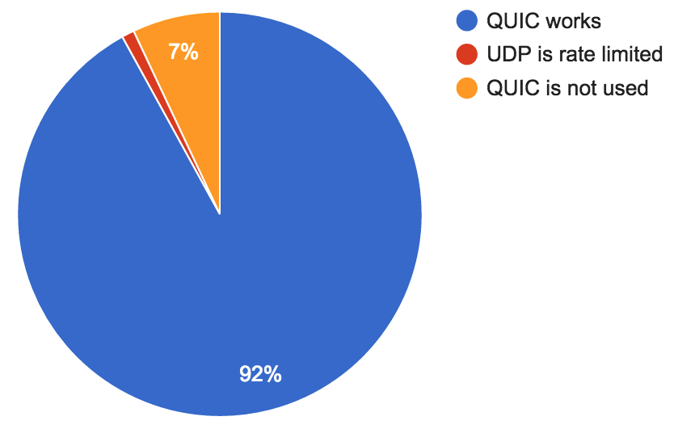
QUIC: Does it work?
QUIC handshakes fail when RTTs are greater than 2.5 seconds or
when UDP is blocked

Slide 23
Performance on Google properties
Faster page loading times
5% faster on average
1 second faster for web search at 99th-percentile
Improved YouTube Quality of Experience
30% fewer rebuffers (video pauses)
Recent Blog Post

Slide 24
Where are the gains from?
0-RTT
Over 50% of the latency improvement (at median and 95th-percentile)
Improved loss recovery
Over 10x fewer timeout based retransmissions improve tail latency and YouTube video rebuffer rates
Other, smaller benefits
e.g. head of line blocking, more efficient framing

Slide 25

Safe
What we’re doing to protect users and networks

Slide 26
Client-side protection
What if UDP is blocked?
Chrome seamlessly falls back to HTTP/TCP
What if the path MTU is too small?
QUIC handshake fails, Chrome falls back to TCP
What if a client doesn’t want to use QUIC?
Chrome flag / administrative policy to disable QUIC
Notes:
UDP Blocked:
Chrome races TCP and QUIC and TCP will win.
Chrome won’t try QUIC for that domain for 5 minutes.
Exponentially back off from there.
Path MTU: QUIC’s handshake packets are a fixed size(1392 bytes) and always the largest packet in a connection.
QoS:

Slide 27
When client-side protection is not enough...
As a last resort, Google disables QUIC to specific ASNs
This is used as a fallback to protocol features
Why do we disable QUIC delivery?
Degraded quality of experience measured
Indications of UDP rate limiting at peak times of day
End user reports (via chromium.org)

Slide 28
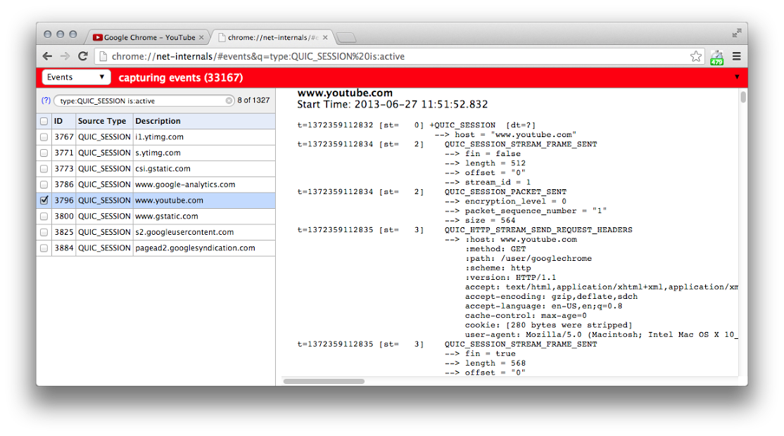
Debugging Tools: Chrome
chrome://net-internals
Active QUIC sessions
Captures all events
Important for filing Chromium bugs

Slide 29
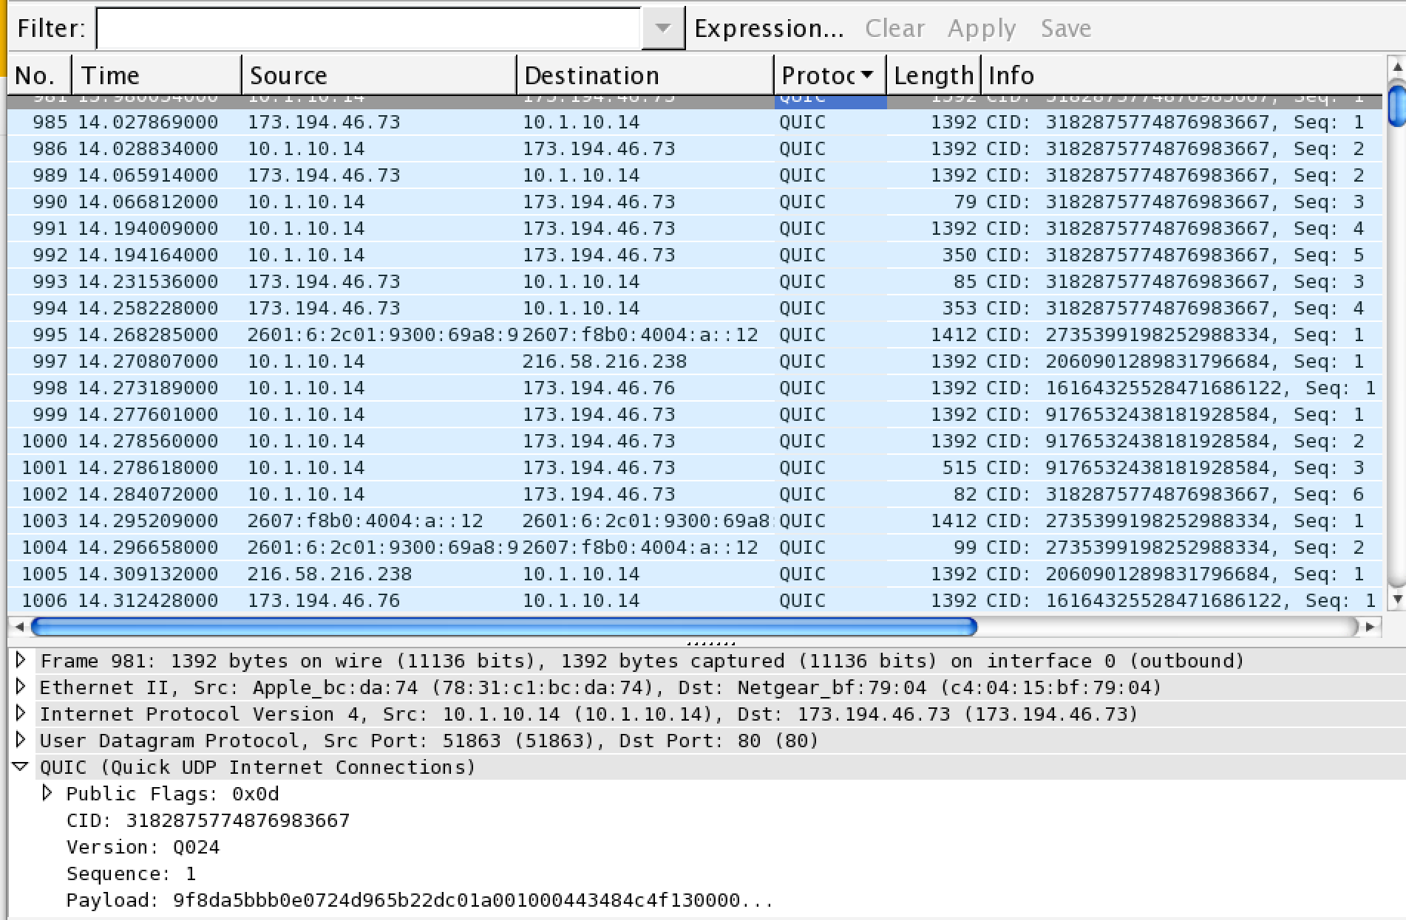
Debugging Tools: Wireshark
Parses
Protocol: QUIC
CID: Connection ID
Seq: Sequence number
Version: ie: Q024
Public flags: 1 byte
Payload: Encrypted

Slide 30

What’s Next?

Slide 31
Future Improvements
Forward Error Correction
Connection Mobility
Multipath
More congestion control experiments

Slide 32
Open source implementations
Servers
Open source test server included in Chromium
Working with other server vendors
Clients
Open source Chromium client library for desktop and mobile
Google Chrome and some Google Android apps
Working with other browsers

Slide 33
QUIC at the IETF
Nov 2013 Initially Presented
Mar 2015 QUIC Crypto
July 2015 BarBoF
Ongoing Subsuming QUIC's 0-RTT handshake in TLS1.3
Now!

Slide 34
Review: QUIC Summary
Reliable, multiplexed transport
Runs over UDP
Always encrypted
Lower latency connection establishment
Optional FEC
Rapidly evolving user-space implementation
Open source

Slide 35
QUIC
Source: QUIC in Chromium
Page: www.chromium.org/quic
Public Mailing list: proto-quic@chromium.org
IETF draft: draft-tsvwg-quic-protocol-01

